Slide 1
Rr Donnelley
Custom point

Slide 2
The link to the Custom Point Login is: https://xs.moorewallace.com

Slide 3
If you do not currently have a User ID and Password Please contact me at: melissa.henry@itwfeg.com or 937-332-2779 Account: VULCANHART (all caps)

Slide 4
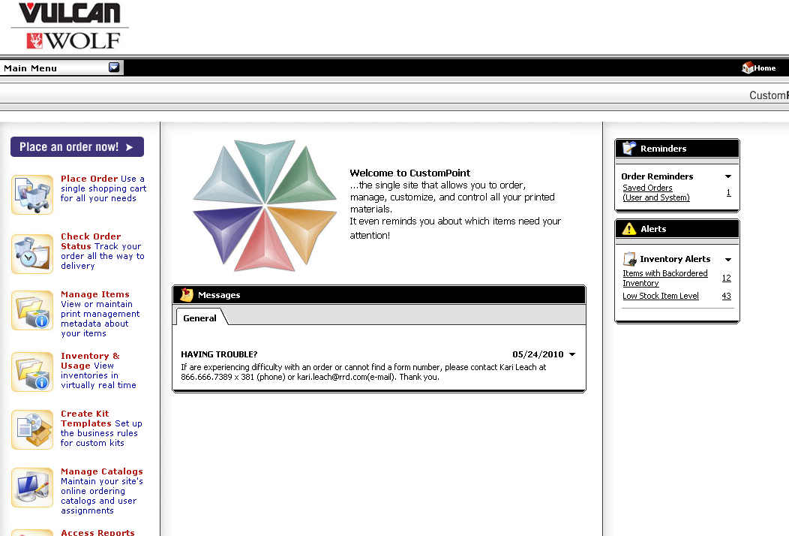
Once you are logged into the site…select “Place Order” from the menu at the left

Slide 5
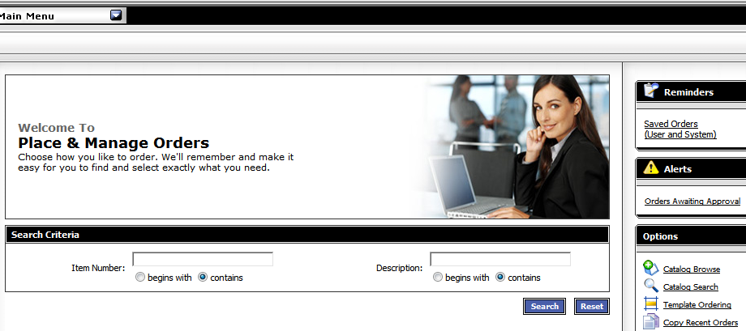
Here enter search criteria:
Enter Item Number (Form Number) OR
Item description
When searching by item number or description, choosing the “contains” button under the search box, this will provide the broadest search

Slide 6
Another Search method is Catalog Browse

Slide 7
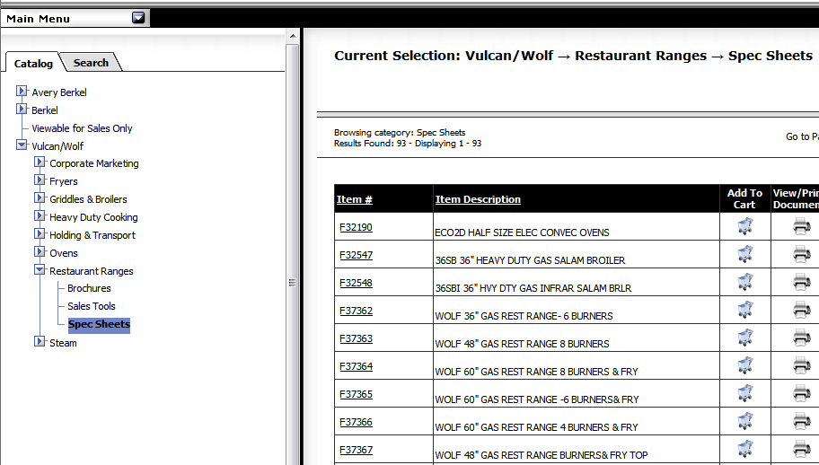
The Catalog Browse option list all options for a
specific product line.

Slide 8
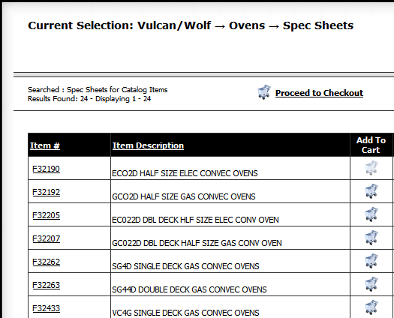
Once you have found the item you are looking for, click “Add to Cart”

Slide 9
Once you “Add to Cart” the “Proceed to Checkout” button will appear at the top of the page

Slide 10
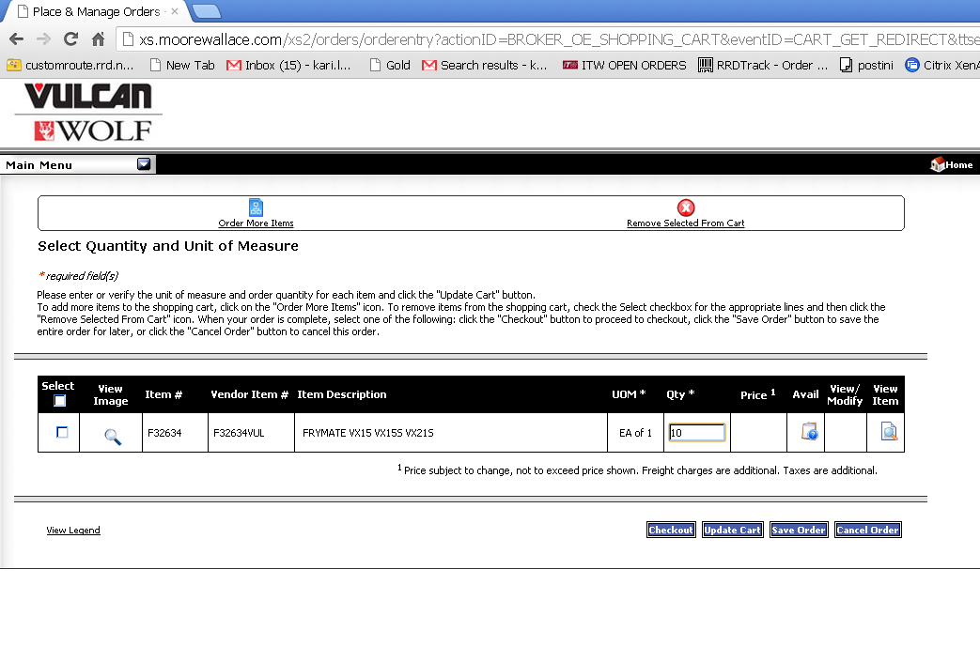
To add more items to your cart, click “Order More Items“ at the top of the checkout screen.

Slide 11
On the checkout screen…Enter the quantity you are ordering. Then choose Checkout – this will take you to the shipping information screen.

Slide 12
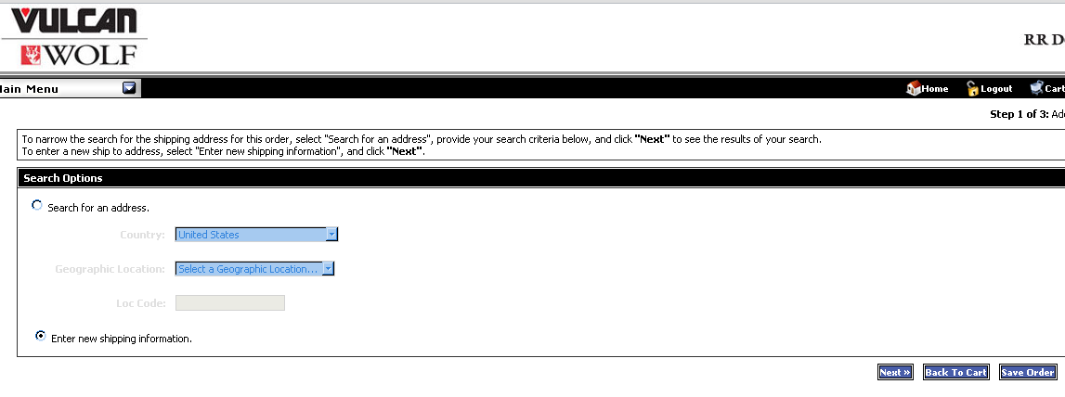
Here enter your shipping address by clicking “Enter new Shipping information”. Click next….

Slide 13
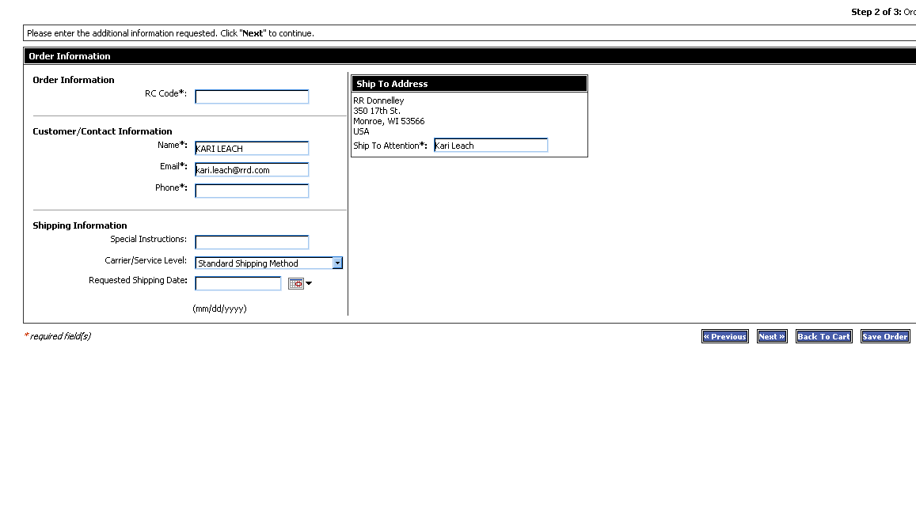
Fields with an asterisk are required. Click Next….

Slide 14
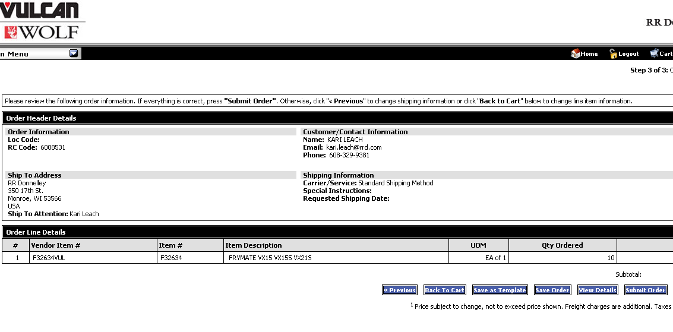
Once you have looked over your order, click Submit. You will also receive an email confirmation of your order.

Slide 15
You can also check on the status of an order …choose “Check Order Status” from the menu at the left

Slide 16
Type in the date range to check status, then search. Your orders will appear below. Then select order details.

Slide 17
This order has been invoiced and shipped.

Slide 18
You now can track it. Click on Tracking,
then double click Tracking Number.

Slide 19
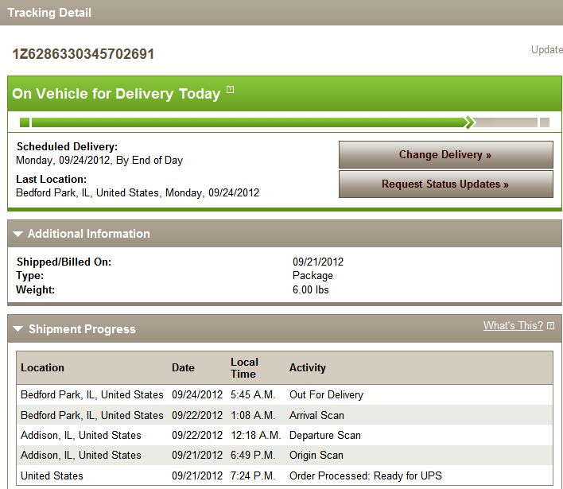
This will give you the carriers tracking details.

Slide 20
Thank you!
For questions, please contact Melissa Henry at (937) 332-2779

